Slide 1
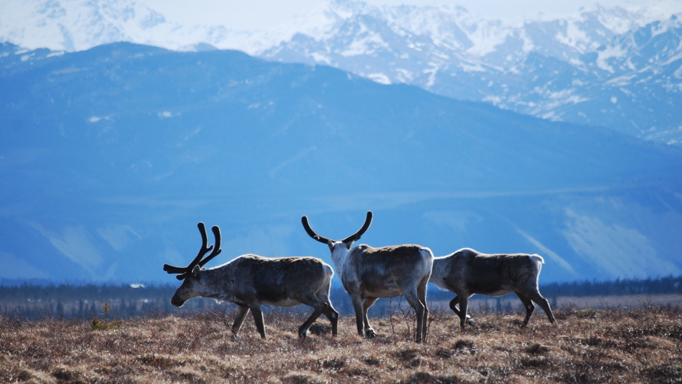
Arctic Boreal Vulnerability Experiment (ABoVE)
2019 ABoVE Airborne Flights
5 July 2019 (DOY 186)
AVIRIS-NG: Interior Alaska
Yukon Flats, Fairbanks, Delta Junction, Healy
Charles Miller, Deputy Science Lead
Jet Propulsion Laboratory, California Institute of Technology
and the ABoVE Science Team
For Hank Margolis, Mike Falkowski, Bruce Tagg, Jack Kaye
NASA HQ
2019

Slide 2

5 July 2019/DOY 186
Yukon Flats, Fairbanks, Healy
Daily Status:
AVIRIS-NG / Dynamic Aviation B-200 (N53W)
REPORT DATE: 5 July 2019
Current Status of Aircraft: GREEN
Current Status of AVIRIS: GREEN
Current Deployment Location: Fairbanks AK (PAFA)
Crew: S Wilson (PIC), C McCann, M Eastwood, L Rios
Science Planning: A Thorpe
Data Processing: W Olsen-Duvall
Instrument Manager: M Eastwood
Instrument PI: R Green
Science Lead: C Miller

Slide 3
5 July 2019/DOY 186
Yukon Flats, Fairbanks, Healy
Daily Summary:
Excellent flight day. Clear sky conditions throughout the Interior
Yukon Flats lines reflown – outstanding data. Complete for 2019
CPCRW flown 2x – out and back from Yukon Flats. Heavy cirrus overhead in both cases
Healy and Denali National Preserve lines acquired - Clear
BNZ LTER, CRREL Tanana River fire scar both acquired – Clear
Fairbanks area – Big Trail Lake – Mostly clear, some smoke; data sent to JPL via UAF/ASF link for rapid methane processing

Slide 4
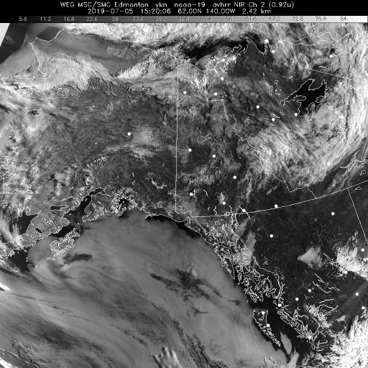
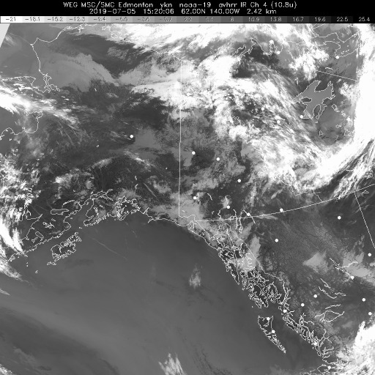
5 July 2019/DOY 186
Yukon Flats, Fairbanks, Healy
Vis 1520Z
IR 1520Z
Notes:
Mostly clear through Interior Alaska; some smoke near fires but clearer than past week

Slide 5
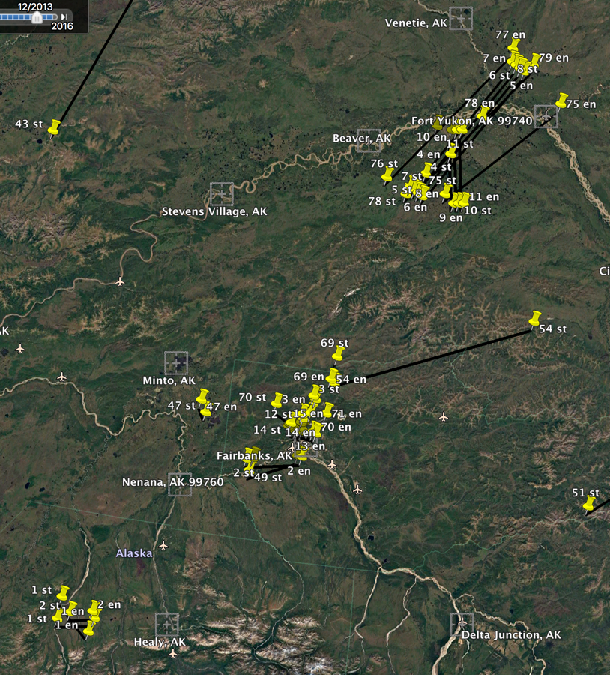
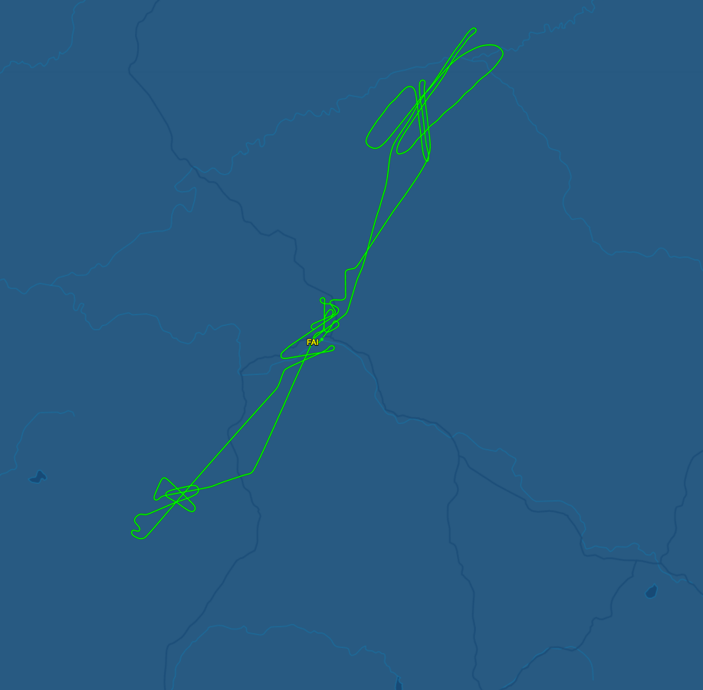
5 July 2019/DOY 186
Yukon Flats, Fairbanks, Healy
Interior Alaska
Planned Lines
Interior Alaska
As-Flown Lines
Fort Yukon
Fairbanks
Healy

Slide 6
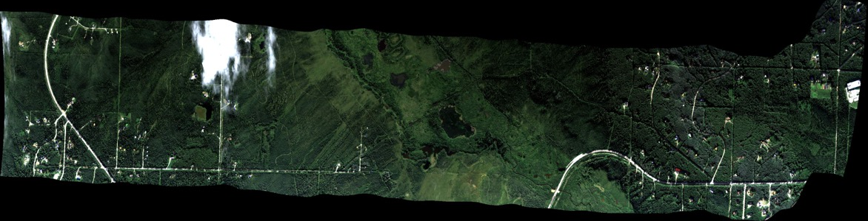
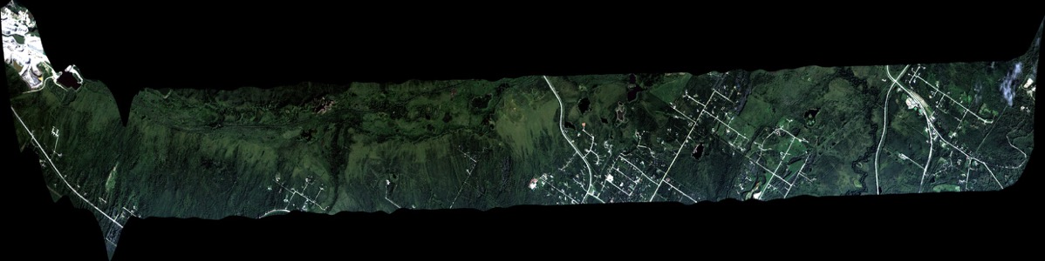
5 July 2019/DOY 186
Yukon Flats, Fairbanks, Healy
AVIRIS-NG Quick-look products
https://avirisng.jpl.nasa.gov/cgi/flights.cgi?step=view_flightlog&flight_id=ang20190705t
A. Line AB_CH4_L002_FL072 , ang20190705t173943_geo : Fairbanks – Big Trail Lake
B. Line AB_CH4_L001_FL183 , ang20190705t174411_geo : Goldstream Valley/Fairbanks Area
A
B
A. One cloud – 2 km overpass
B. Small cloud interference – 6 km overpass
Notes:
Review 7/19/19
Green – small cloud
Green – small cloud

Slide 7
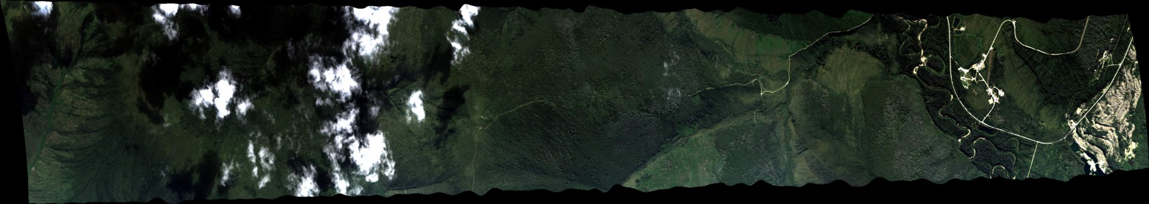
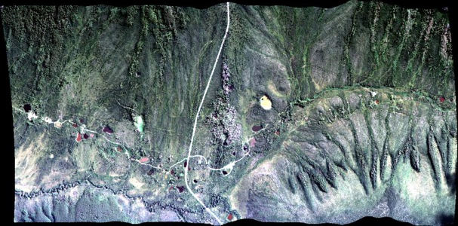
5 July 2019/DOY 186
Yukon Flats, Fairbanks, Healy
AVIRIS-NG Quick-look products
https://avirisng.jpl.nasa.gov/cgi/flights.cgi?step=view_flightlog&flight_id=ang20190705t
A. Line AB_CH4_L006_FL072 , ang20190705t175209_geo : Fairbanks area/Vault Lake
B. Line AVng_258A-258Z_FL190 , ang20190705t175603_geo : NEON CPCRW
A
B
A. One cloud
B. Small cloud interference
Notes:
Review 7/19/19
Green
Green/Yellow – depends on whether clouds interfere with NEON box

Slide 8
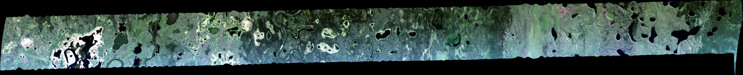
5 July 2019/DOY 186
Yukon Flats, Fairbanks, Healy
AVIRIS-NG Quick-look products
https://avirisng.jpl.nasa.gov/cgi/flights.cgi?step=view_flightlog&flight_id=ang20190705t
A. Line BirchCrkS_L003_FL180 , ang20190705t181521_geo : Yukon Flats
B. Line BirchCrkS_L002_FL180 , ang20190705t182451_geo : Yukon Flats
A
B
A. Some haze but excellent image; interesting lake productivity in middle of image
B. Nice image; small orthorectification glitch at end
Notes:
7/19/19 Review
Green
Green

Slide 9
5 July 2019/DOY 186
Yukon Flats, Fairbanks, Healy
AVIRIS-NG Quick-look products
https://avirisng.jpl.nasa.gov/cgi/flights.cgi?step=view_flightlog&flight_id=ang20190705t
A. Line BirchCrkS_L001_FL180 , ang20190705t183406_geo : Yukon Flats
B. Line AVng_321A-321B_FL178 , ang20190705t184244_geo : Yukon Flats
A
B
A. Excellent
B. Nice image
Notes:
Review 7/19/19
Green
Green

Slide 10
5 July 2019/DOY 186
Yukon Flats, Fairbanks, Healy
AVIRIS-NG Quick-look products
https://avirisng.jpl.nasa.gov/cgi/flights.cgi?step=view_flightlog&flight_id=ang20190705t
A. Line AVng_322A-322B_FL179 , ang20190705t185207_geo : Yukon Flats
B. Line AVng_323A-323Z_FL179 , ang20190705t190858_geo : Yukon Flats
A
B
A. Good image; orthorectification issue at end
B. Nice image; Yukon River brightness darkens rest of image
Notes:
7/19/19 Review
Green
Green

Slide 11
5 July 2019/DOY 186
Yukon Flats, Fairbanks, Healy
AVIRIS-NG Quick-look products
https://avirisng.jpl.nasa.gov/cgi/flights.cgi?step=view_flightlog&flight_id=ang20190705t
A. Line BirchCrkN_L001_FL179 , ang20190705t192514_geo : Yukon Flats
B. Line BirchCrkN_L002_FL179 , ang20190705t194149_geo : Yukon Flats
A
B
A. Yukon River seen at right
B. Nice image
Notes:
7/19/19 Review
Green
Green

Slide 12
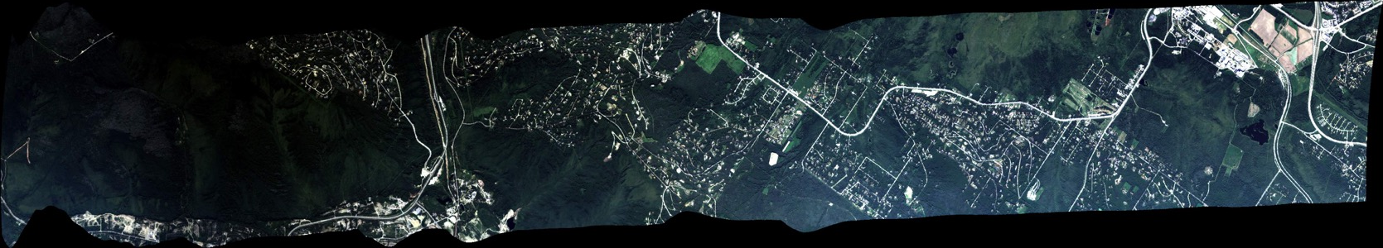
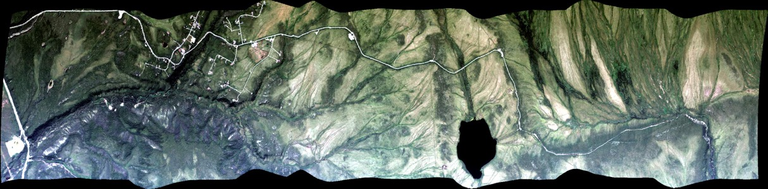
5 July 2019/DOY 186
Yukon Flats, Fairbanks, Healy
AVIRIS-NG Quick-look products
https://avirisng.jpl.nasa.gov/cgi/flights.cgi?step=view_flightlog&flight_id=ang20190705t
A. Line AVng_254A-254Z_FL183 , ang20190705t201300_geo : NEON CPCRW
B. Line AVng_242A-242Z_FL194 , ang20190705t203320_geo : Healy
A
B
A. NEON Caribou Poker Creek
B. Healy village and 8 Mile Lake
Notes:
7/19/19
Yellow – log lists heavy cirrus above
GREEN

Slide 13
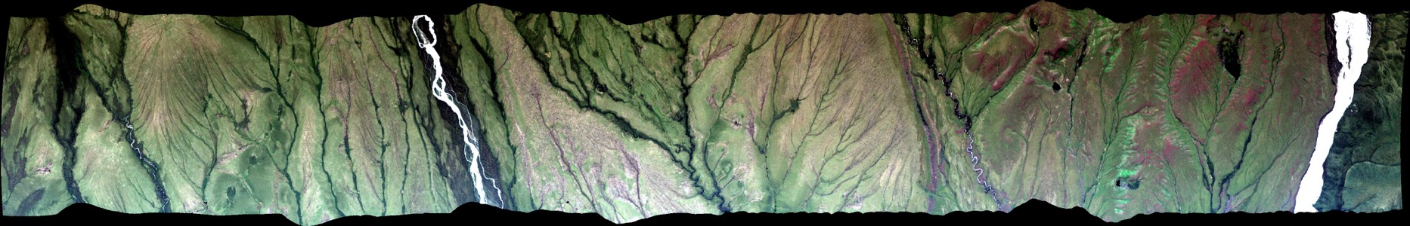
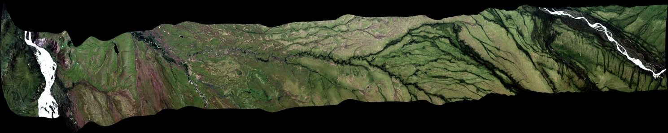
5 July 2019/DOY 186
Yukon Flats, Fairbanks, Healy
AVIRIS-NG Quick-look products
https://avirisng.jpl.nasa.gov/cgi/flights.cgi?step=view_flightlog&flight_id=ang20190705t
A. Line AVng_246A-246Z_FL193 , ang20190705t203904_geo : Denali National Park
B. Line AVng_243A-243Z_FL192 , ang20190705t204649_geo : Denali National Park
A
B
A. Healy area
B. Healy area
Notes:
7/19/19 Review
GREEN
GREEN

Slide 14
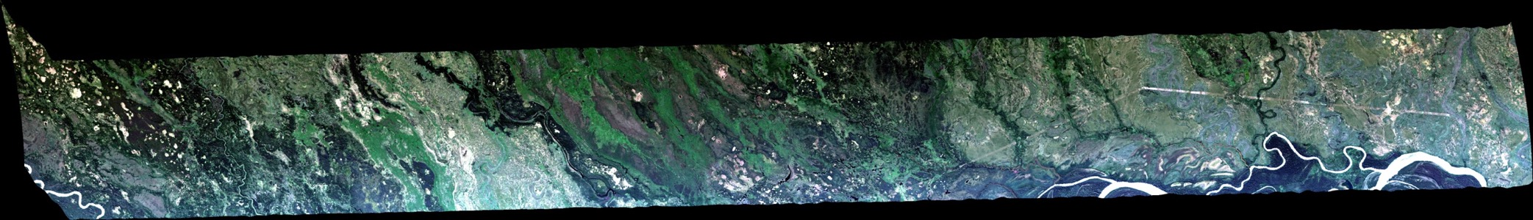
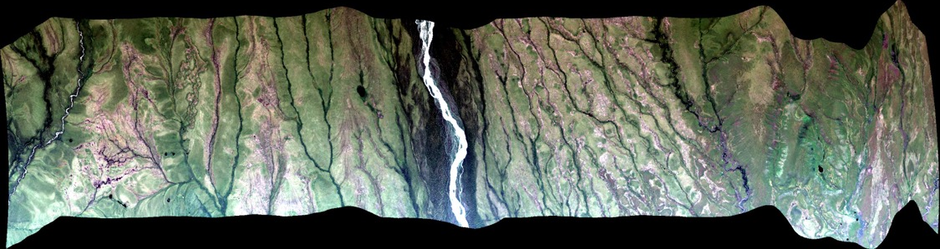
5 July 2019/DOY 186
Yukon Flats, Fairbanks, Healy
AVIRIS-NG Quick-look products
https://avirisng.jpl.nasa.gov/cgi/flights.cgi?step=view_flightlog&flight_id=ang20190705t
A. Line AVng_247A-247Z_FL192 , ang20190705t205605_geo : Denali National Park
B. Line AVng_252A-252Z_FL179 , ang20190705t213350_geo : CRREL Tanana River fire scar/lidar
A
B
A. Healy area
B. Tanana River
Notes:
7/19/19 Review
GREEN
GREEN

Slide 15
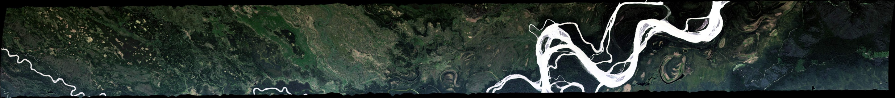
5 July 2019/DOY 186
Yukon Flats, Fairbanks, Healy
AVIRIS-NG Quick-look products
https://avirisng.jpl.nasa.gov/cgi/flights.cgi?step=view_flightlog&flight_id=ang20190705t
A. Line AVng_251A-251Z_FL179 , ang20190705t213948_geo : BNZ LTER
A
B
Purposely left blank
A. Nice imagery of the flood plain up the hill
Notes:
7/19/19 Review
A. GREEN

Slide 16
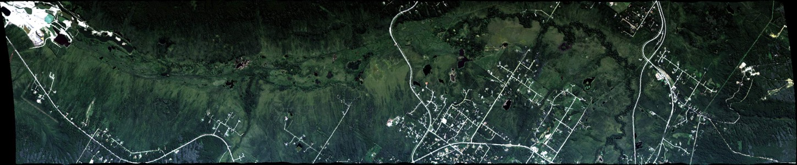
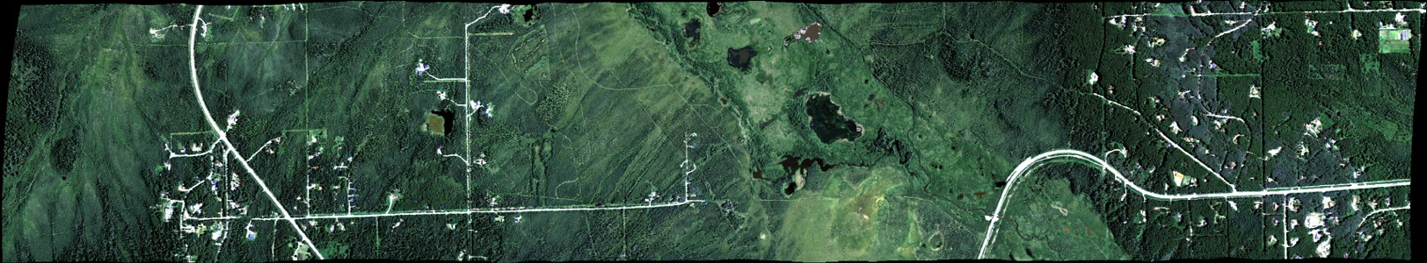
5 July 2019/DOY 186
Yukon Flats, Fairbanks, Healy
AVIRIS-NG Quick-look products
https://avirisng.jpl.nasa.gov/cgi/flights.cgi?step=view_flightlog&flight_id=ang20190705t
A. Line AB_CH4_L001_FL183 , ang20190705t214942_geo : Goldstream Valley /Fairbanks area, Big Trail Lake
B. Line AB_CH4_L002_FL072 , ang20190705t215802_geo : Fairbanks area, Big Trail Lake
A
B
A. Standard 6 km altitude
B. Approx 2 km altitude, 3x better spatial resolution
Notes:
7/19/19 Review
GREEN
GREEN

Slide 17
Backup

